Slide 1

7th Grade Accelerated Grade
Unit 1, Lesson 10 Solving Inequalities – Part 2 Volume 1, pg. 55

Slide 2


Benchmark
MA.8.AR.2.2
Solve two-step linear inequalities in one variable and represent solutions algebraically and graphically.
volume 1, pg. 55

Slide 3
Integrated Mathematical Thinking and Reasoning Standards
MA.K12.MTR.1.1 Actively participate in effortful learning both individually and collectively.
MA.K12.MTR.2.1 Demonstrate understanding by representing problems in multiple ways.
MA.K12.MTR.4.1 Engage in discussions that reflect on the mathematical thinking of self and others.
MA.K12.MTR.5.1 Use patterns and structure to help understand and connect mathematical concepts.
MA.K12.MTR.6.1 Assess the reasonableness of solutions.
volume 1, pg. 55

Slide 4

Learning Target
I can solve inequalities and represent the solutions on a number line.
volume 1, pg. 55

Slide 5

Warm-Up
volume 1, pg. 56

Slide 6

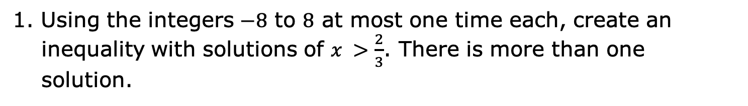
1.10.1 Warm-Up: Creating Inequalities
1. Using the integers $−8$ to $8$ at most one time each, create an inequality with solutions of $x >\frac{2}{3}$. There is more than one solution.
volume 1, pg. 56

Slide 7

Try It
volume 1, pg. 56

Slide 8

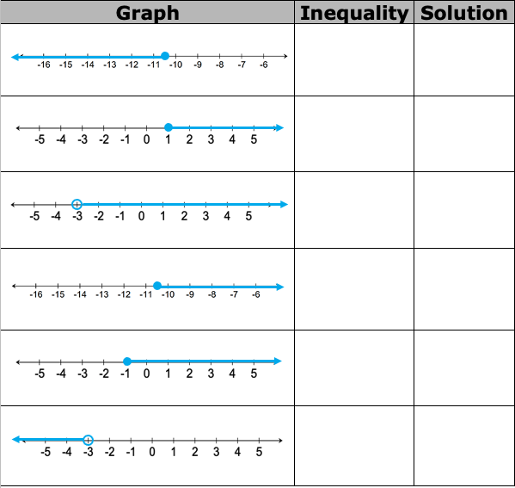
1.10.2 Try It: Card Match
1. Work with your partner to match the provided inequality and solution cards to each graph in the table.
volume 1, pg. 56

Slide 9

Your Turn
volume 1, pg. 57

Slide 10
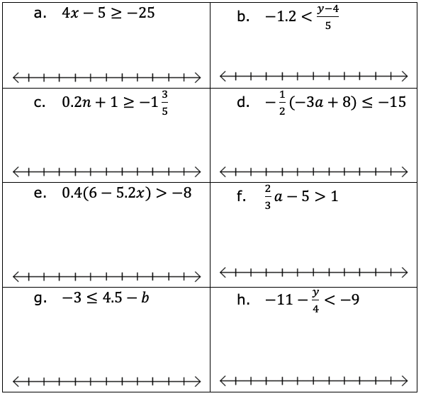
1.10.3 Your Turn!
1. Solve each inequality and represent the solutions on the number line.
volume 1, pg. 57

Slide 11

Collaboration
volume 1, pg. 57

Slide 12

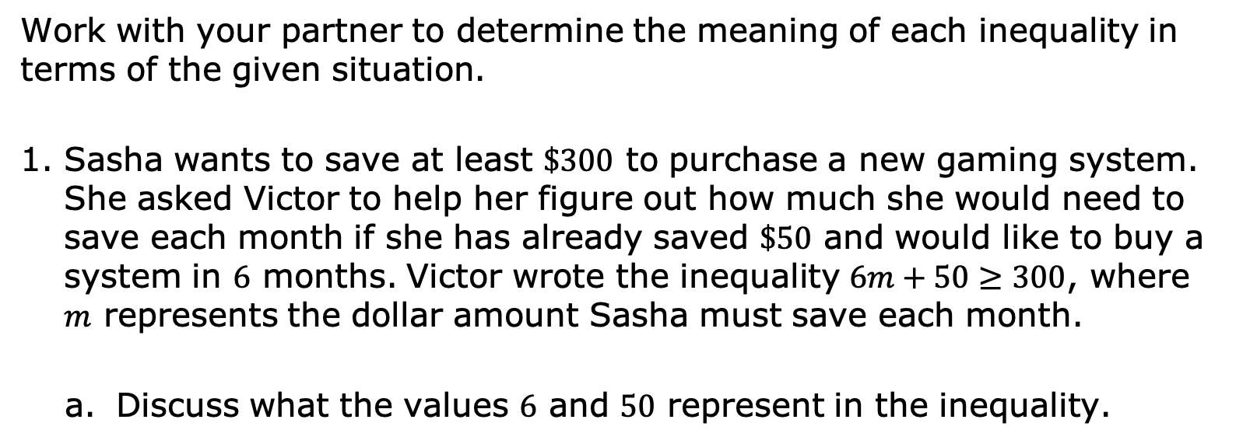
1.10.4 Collaboration: Solving Real-World Inequalities
Work with your partner to determine the meaning of each inequality in terms of the given situation.
Sasha wants to save at least $\$300$ to purchase a new gaming system. She asked Victor to help her figure out how much she would need to save each month if she has already saved $\$50$ and would like to buy a system in $6$ months. Victor wrote the inequality $6m+50≥300$, where $m$ represents the dollar amount Sasha must save each month.
Discuss what the values $6$ and $50$ represent in the inequality.
volume 1, pg. 57

Slide 13
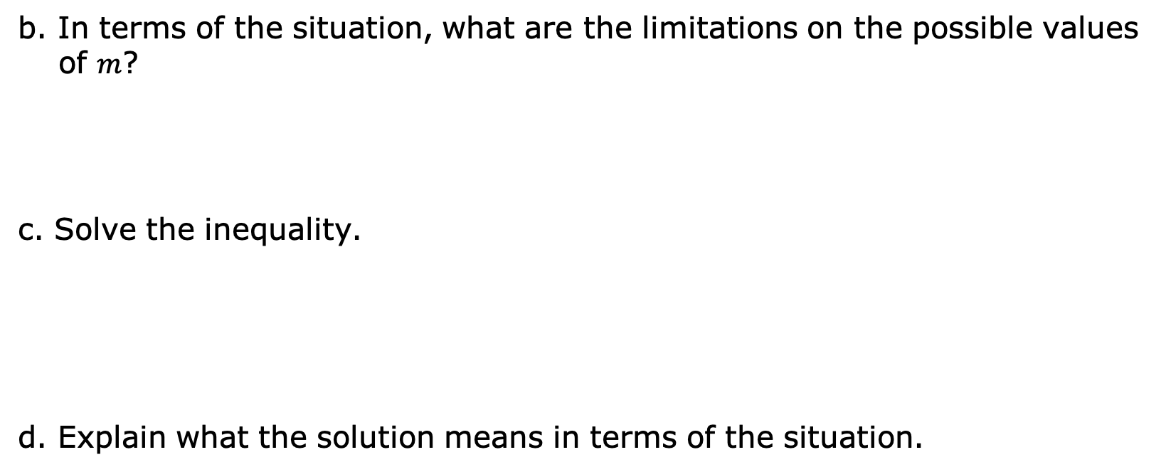
b. In terms of the situation, what are the limitations on the possible values of $m$?
c. Solve the inequality.
d. Explain what the solution means in terms of the situation.
volume 1, pg. 57

Slide 14
2. Sasha received $100 for her birthday and hopes to buy 4 video games for her gaming system. Each game usually costs $40, but she’s hoping she can find the games on sale this week. She writes the inequality 4(40-d)≤100, where d represents the dollar amount of the discount on the video games.
a. What does the expression 40-d represent?
b. Solve the inequality.
c. Explain what the solution means in terms of the situation.
d. Do you think it is likely that Sasha will be able to purchase the 4 video games she wants?
volume 1, pg. 58

Slide 15

Wrap-Up
volume 1, pg. 58

Slide 16
1.10.5 Wrap-Up: Cool Down
Write an explanation to a classmate who might have missed today’s lesson, in your own words, about how the process for solving an inequality is different than solving an equation.
volume 1, pg. 58

